Slide 1
Knowledge Augmentation of LLM in Sequential tasks
申珽嘉 汪克凡

Slide 2
Catalog
Background
Problem Definition
Methods Summary
Knowledge Augmentation for Generative LLM
Generative LLM for Knowledge Augmentation
Discriminative Model
Resources and supplement
Outlook

Slide 3
Catalog
Background
Problem Definition
Methods Summary
Knowledge Augmentation for Generative LLM
Generative LLM for Knowledge Augmentation
Discriminative Model
Resources and supplement
Outlook

Slide 4
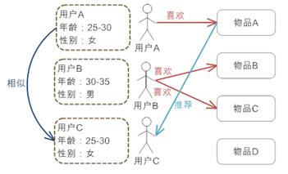
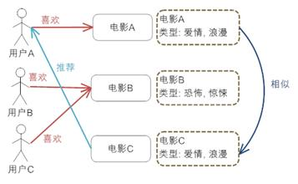
Background
Sequential Recommendation
Alleviating information overload.
Selecting the optimal match between users and products.
Recommendation Methods
Demographic-based recommendation
Content-based recommendation
Collaborative filtering recommendation
Demographic-based recommendation
Content-based recommendation

Slide 5
Background
LLM for Rec
Traditional recommendation models primarily rely on co-occurrence information, with limited capabilities in utilizing textual information. In contrast, large models inherently possess text processing capabilities.
The open-domain knowledge embedded in large models can effectively enhance the zero-shot/few-shot capabilities of recommendation models.
The deep Transformer in large models brings about enhanced inferential abilities.
LLM in Recommendation System
i. Knowledge Augmentation for Generative LLM
ii. Generative LLM for Knowledge Augmentation
iii. Discriminative Model
prompt
tuning
LLM
result
LLM
Rec
model
result
LLM
Rec
model
result
text
embedding
i
ii
iii

Slide 6
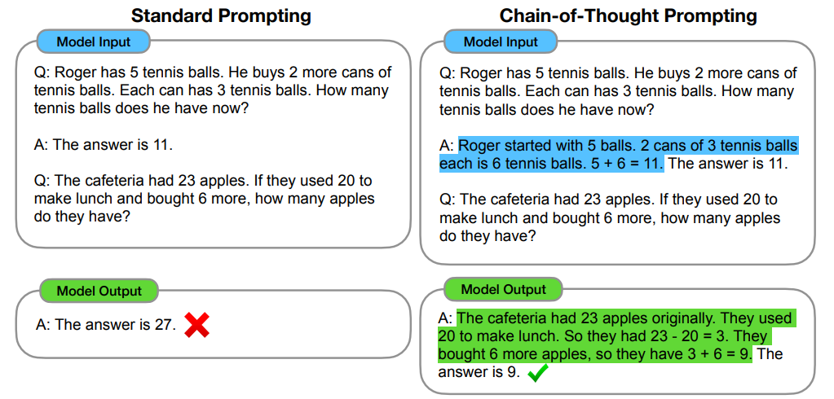
Background
Chain-of-Thought Prompting Elicits Reasoning in Large Language Models
Stimulate the logical reasoning capabilities of large models
Manually constructed logic >> Automatically
Notes:
TALLRec: An Effective and Efficient Tuning Framework to Align Large Language Model with Recommendation
https://arxiv.org/pdf/2305.00447.pdf

Slide 7
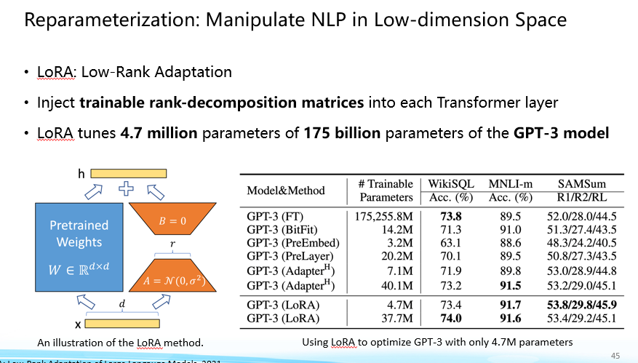
Background
LoRA: Low-Rank Adaptation of Large Language Models
About 6% parameters
Notes:
LoRA: Low-Rank Adaptation of Large Language Models
https://arxiv.org/abs/2106.09685

Slide 8
Catalog
Background
Problem Definition
Methods Summary
Knowledge Augmentation for Generative LLM
Generative LLM for Knowledge Augmentation
Discriminative Model
Resources
Outlook

Slide 9

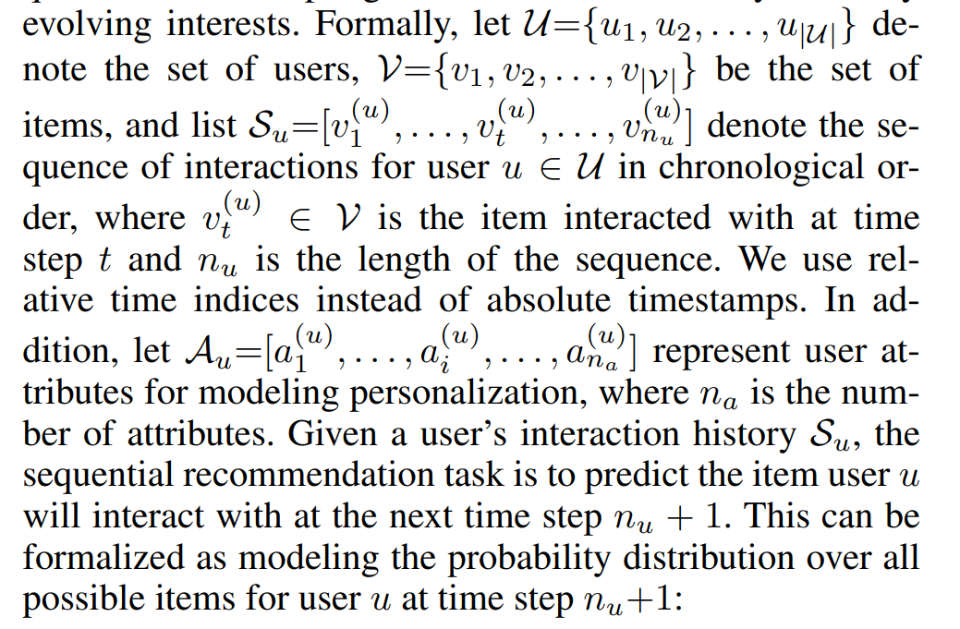
Knowledge Augmentation for Generative LLM
Problem Definition
Given a sequence of items and text information about users and items, try to predict the next item or whether an item should be recommended
Notes:
Knowledge Prompt-tuning for Sequential Recommendation
https://arxiv.org/abs/2308.08459

Slide 10
Catalog
Background
Problem Definition
Methods Summary
Knowledge Augmentation for Generative LLM
Prompt construction
Knowledge Graph
Representation
Prompt optimization
Mask denoising
Rerank
Generative LLM for Knowledge Augmentation
Discriminative Model
Resources and supplement
Outlook

Slide 11
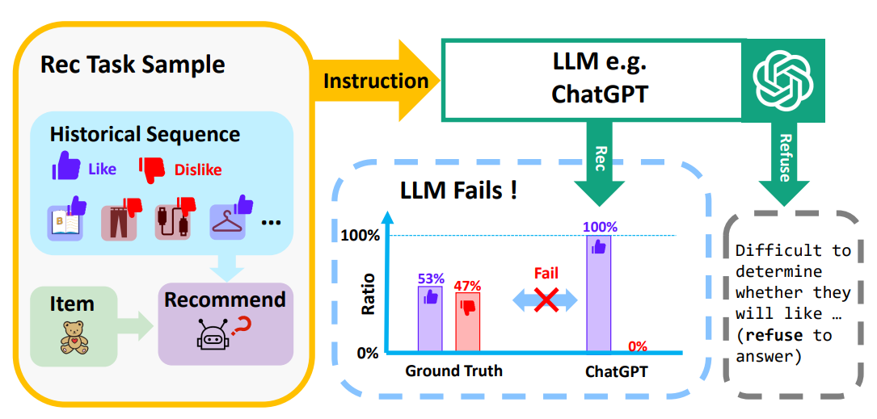
Knowledge Augmentation for Generative LLM
TALLRec: An Effective and Efficient Tuning Framework to Align Large Language Model with Recommendation
Simple SFT
Notes:
TALLRec: An Effective and Efficient Tuning Framework to Align Large Language Model with Recommendation
https://arxiv.org/pdf/2305.00447.pdf

Slide 12
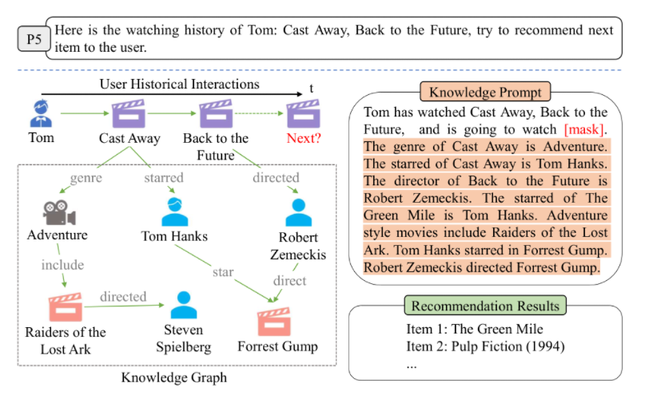
Knowledge Augmentation for Generative LLM
Knowledge Prompt-tuning for Sequential Recommendation
Introduce an external knowledge base and propose Knowledge Prompt-tuning for Sequential Recommendation
Notes:
Knowledge Prompt-tuning for Sequential Recommendation
https://arxiv.org/abs/2308.08459

Slide 13
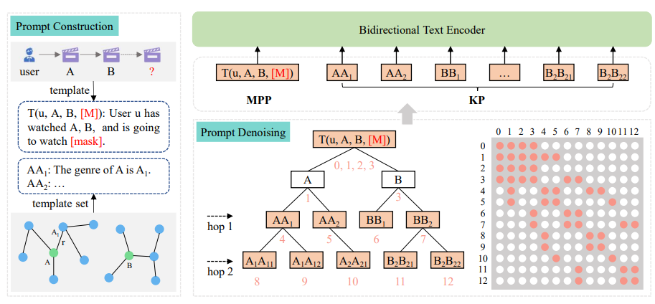
Knowledge Augmentation for Generative LLM
Knowledge Prompt-tuning for Sequential Recommendation
Forming a search tree in target graph
Notes:
Knowledge Prompt-tuning for Sequential Recommendation
https://arxiv.org/abs/2308.08459

Slide 14
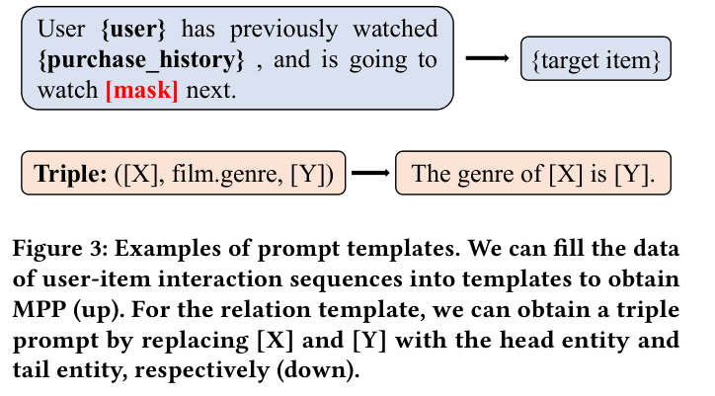
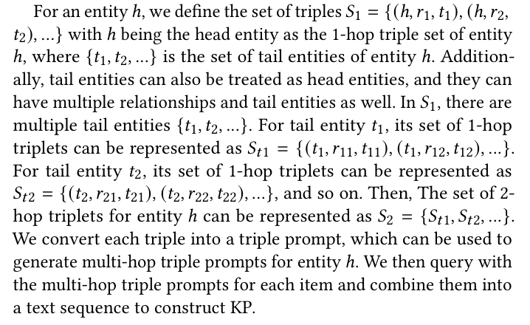
Knowledge Augmentation for Generative LLM
Knowledge Prompt-tuning for Sequential Recommendation
Two Kind of prompt
LLM: P5 (not decoder-only)
Notes:
Knowledge Prompt-tuning for Sequential Recommendation
https://arxiv.org/abs/2308.08459

Slide 15
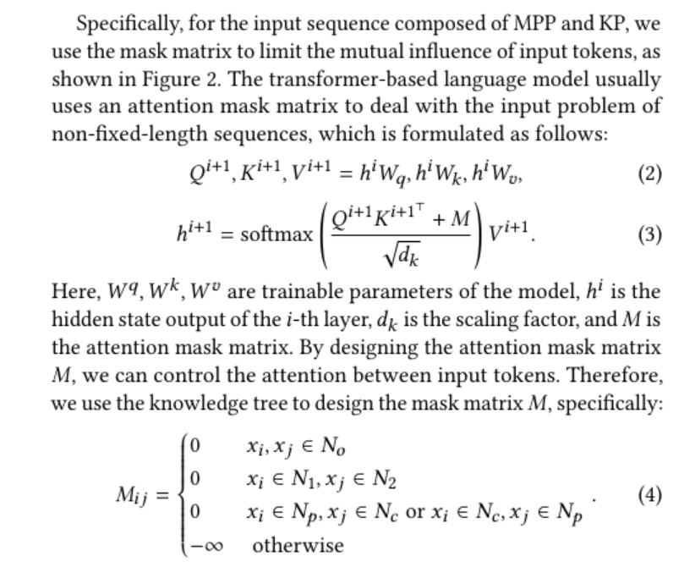
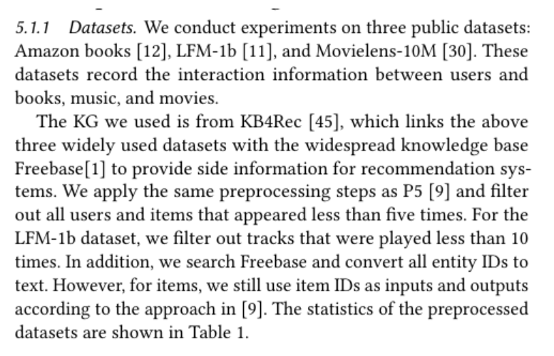
Knowledge Augmentation for Generative LLM
Knowledge Prompt-tuning for Sequential Recommendation
Prompt Denoising Module
Notes:
Knowledge Prompt-tuning for Sequential Recommendation
https://arxiv.org/abs/2308.08459

Slide 16
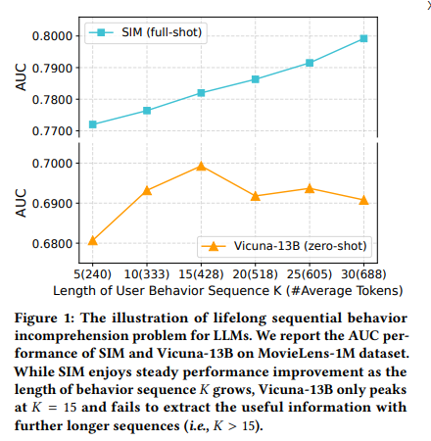
Knowledge Augmentation for Generative LLM
ReLLa: Retrieval-enhanced Large Language Models for Lifelong Sequential Behavior Comprehension in Recommendation
alleviates the problem that it is difficult to understand long sequences of LLM
Notes:
ReLLa: Retrieval-enhanced Large Language Models for Lifelong Sequential Behavior Comprehension in Recommendation
https://arxiv.org/abs/2308.11131

Slide 17
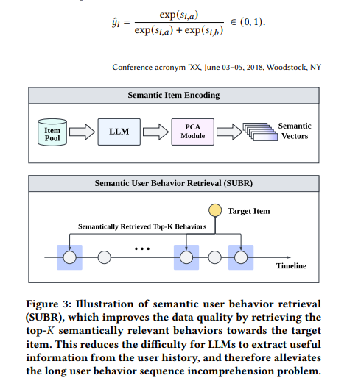
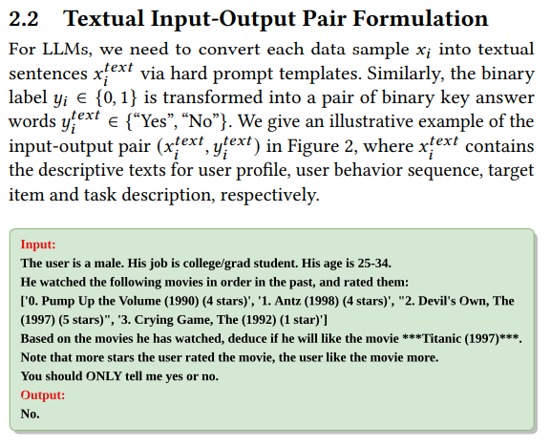
Knowledge Augmentation for Generative LLM
ReLLa: Retrieval-enhanced Large Language Models for Lifelong Sequential Behavior Comprehension in Recommendation
Zero-shot：prompt construction
Few-shot：data augmentation (Prevent overfitting.)
Notes:
ReLLa: Retrieval-enhanced Large Language Models for Lifelong Sequential Behavior Comprehension in Recommendation
https://arxiv.org/abs/2308.11131

Slide 18
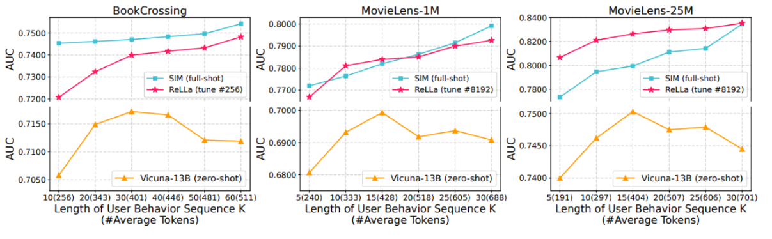
Knowledge Augmentation for Generative LLM
ReLLa: Retrieval-enhanced Large Language Models for Lifelong Sequential Behavior Comprehension in Recommendation
Zero-shot：prompt construction
Few-shot：data augmentation (Prevent overfitting.)
Notes:
ReLLa: Retrieval-enhanced Large Language Models for Lifelong Sequential Behavior Comprehension in Recommendation
https://arxiv.org/abs/2308.11131

Slide 19
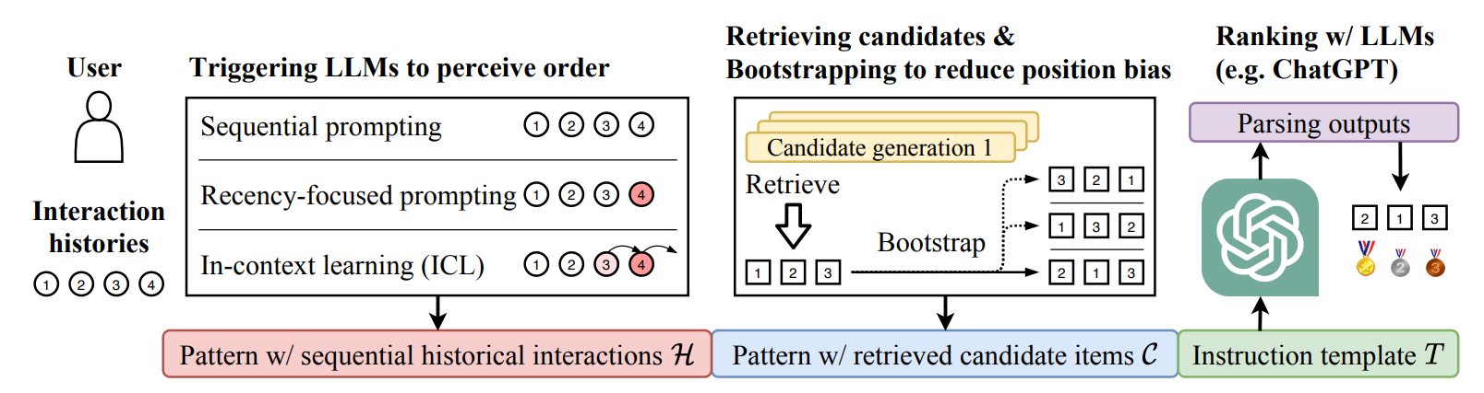
Knowledge Augmentation for Generative LLM
Large Language Models are Zero-Shot Rankers for Recommender Systems
Sequence item rerank
Notes:
Large Language Models are Zero-Shot Rankers for Recommender Systems
https://arxiv.org/pdf/2305.08845.pdf
introduced two prompting methods to improve the sequential recommendation ability of LLMs: recencyfocused sequential prompting, enabling LLMs to perceive the sequential information in the user interaction history, and bootstrapping, shuffling the candidate item list multiple times and taking the average scores for ranking to alleviate the position bias problem.

Slide 20
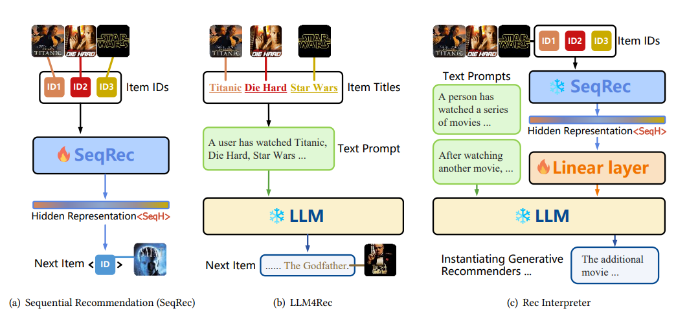
Knowledge Augmentation for Generative LLM
Large Language Model Can Interpret Latent Space of Sequential Recommender
Tunable representation layer instead of LoRA
Notes:
Large Language Model Can Interpret Latent Space of Sequential Recommender
https://arxiv.org/pdf/2310.20487.pdf

Slide 21
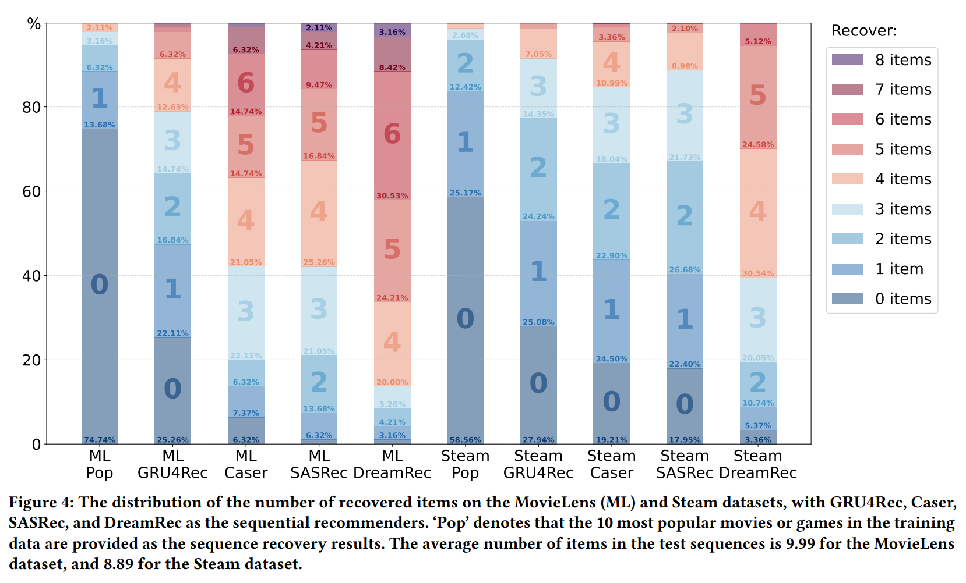
Knowledge Augmentation for Generative LLM
Large Language Model Can Interpret Latent Space of Sequential Recommender
Tunable representation layer instead of LoRA
Notes:
Large Language Model Can Interpret Latent Space of Sequential Recommender
https://arxiv.org/pdf/2310.20487.pdf

Slide 22
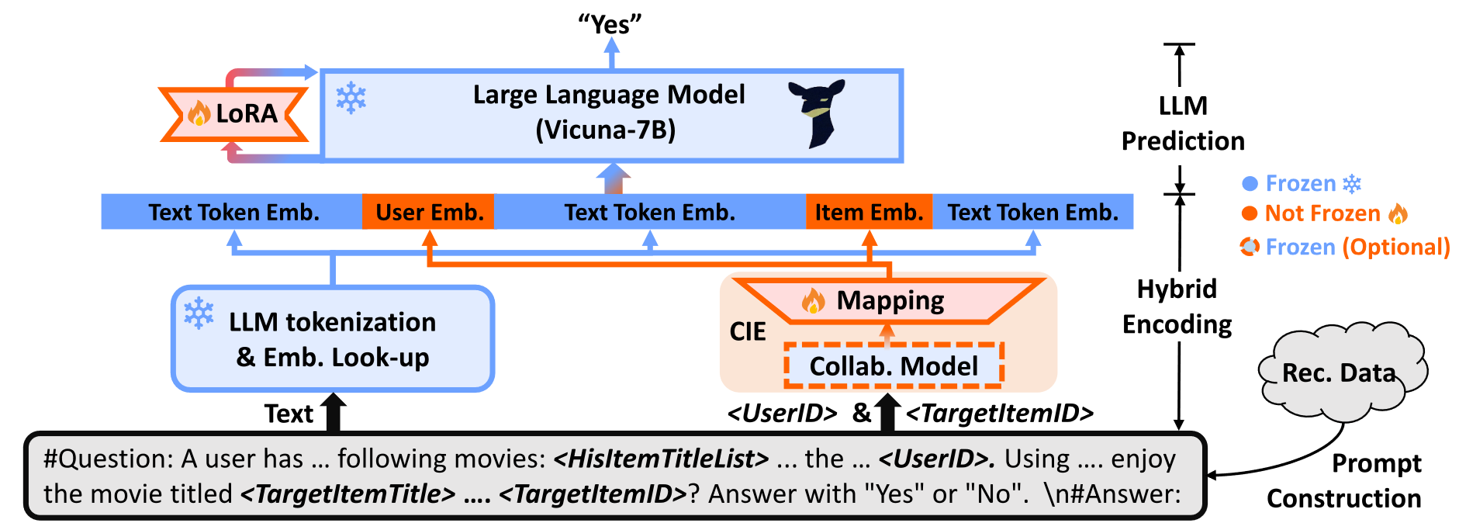
Knowledge Augmentation for Generative LLM
CoLLM: Integrating Collaborative Embeddings into Large Language Models for Recommendation
Placing user embedding and item embedding in the corresponding token positions after the first layer of the larger model.
Zhang, Yang, et al. "CoLLM: Integrating Collaborative Embeddings into Large Language Models for Recommendation." arXiv preprint arXiv:2310.19488 (2023).

Slide 23
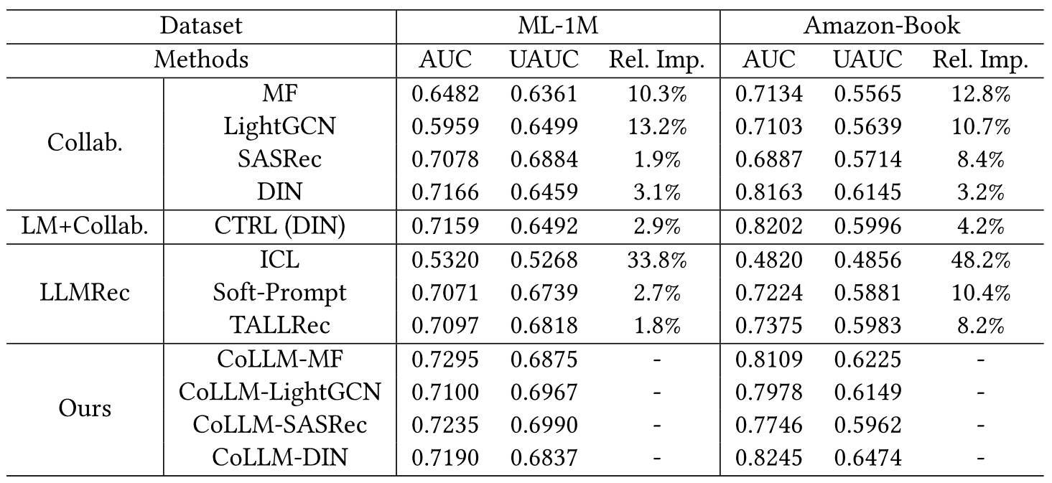
Knowledge Augmentation for Generative LLM
CoLLM: Integrating Collaborative Embeddings into Large Language Models for Recommendation
Performance.
Zhang, Yang, et al. "CoLLM: Integrating Collaborative Embeddings into Large Language Models for Recommendation." arXiv preprint arXiv:2310.19488 (2023).

Slide 24
Catalog
Background
Problem Definition
Methods Summary
Knowledge Augmentation for Generative LLM
Generative LLM for Knowledge Augmentation
Data Augmentation
Reason Augmentation
Multi-model Augmentation
Ensemble
Iteration
Discriminative Model
Resources and supplement
Outlook

Slide 25
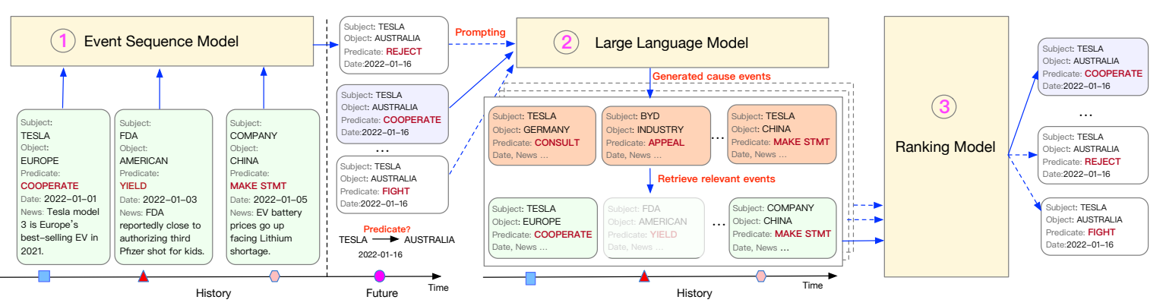
Generative LLM for Knowledge Augmentation
Language Models Can Improve Event Prediction by Few-Shot Abductive Reasoning
Notes:
Language Models Can Improve Event Prediction by Few-Shot Abductive Reasoning
https://arxiv.org/pdf/2305.16646.pdf

Slide 26
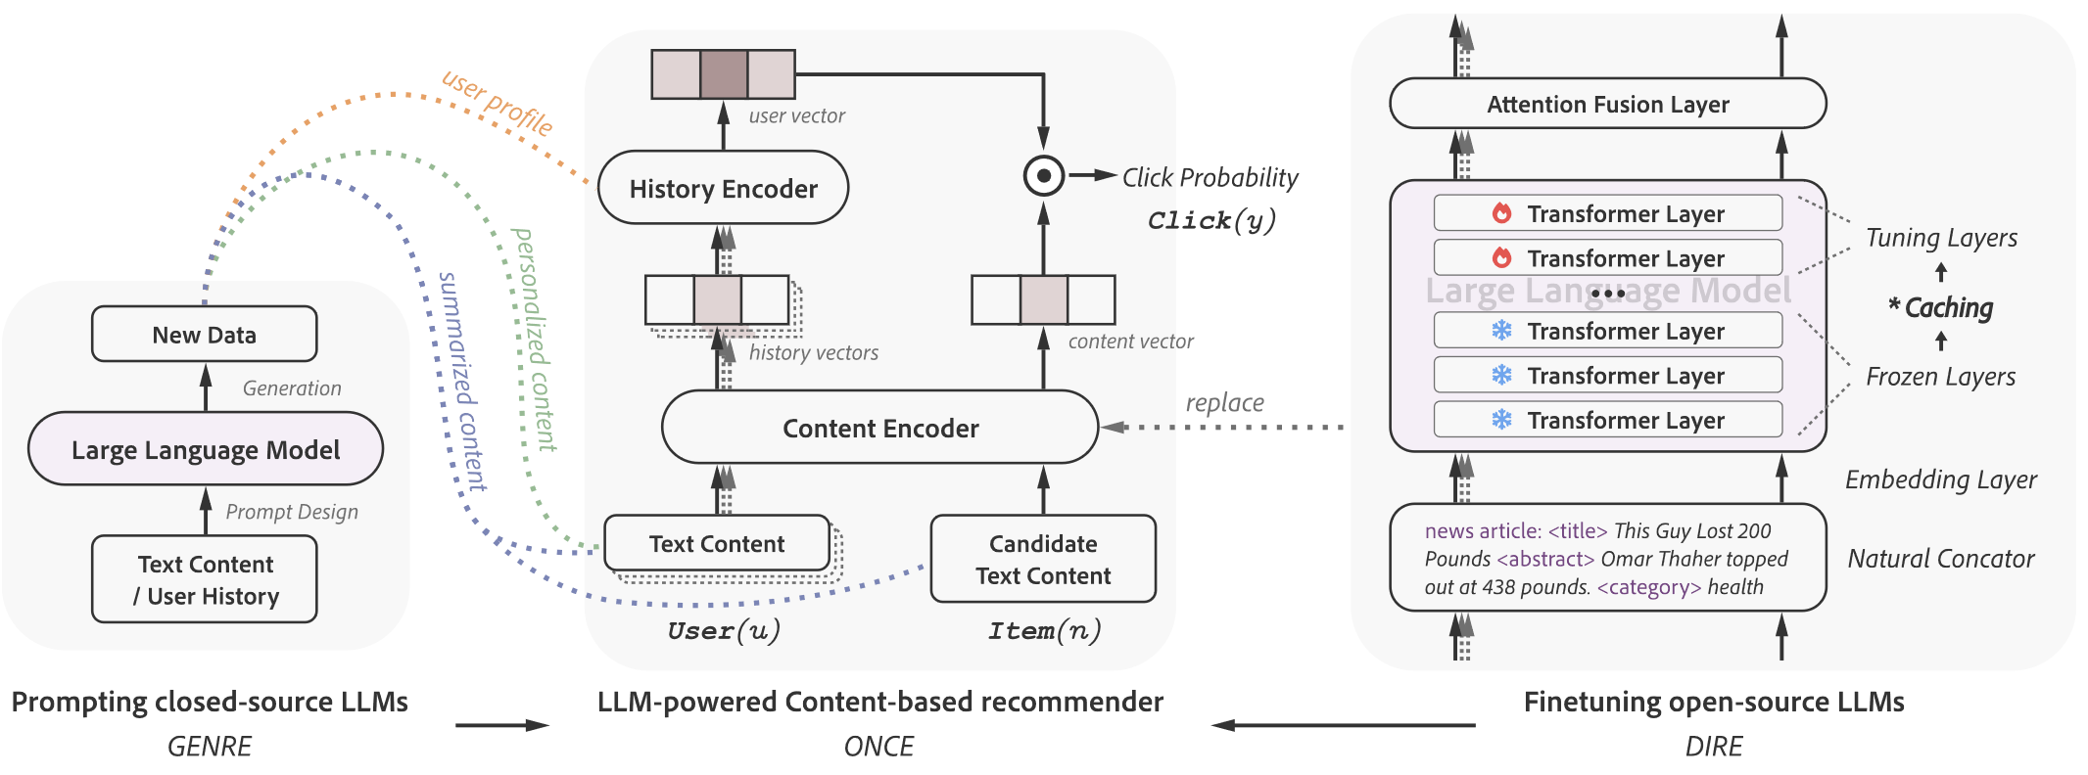
Generative LLM for Knowledge Augmentation
ONCE: Boosting Content-based Recommendation with Both Open- and Closed-source Large Language Models
Generating enhanced textual information using closed-source LLM.
Generating embeddings using open-source PLM.
Liu, Qijiong, et al. "ONCE: Boosting Content-based Recommendation with Both Open- and Closed-source Large Language Models." arXiv preprint arXiv:2305.06566 (2023).

Slide 27
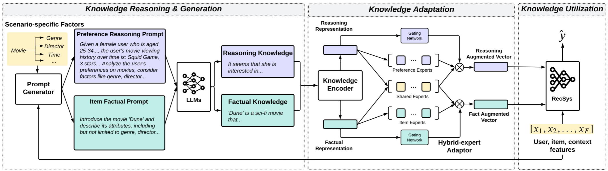
Generative LLM for Knowledge Augmentation
Towards Open-World Recommendation with Knowledge Augmentation from Large Language Models
Using LLM to expand user information and product information and infer user preferences based on user history sequence.
Using large models as knowledge base to enhance user and product representation while ensuring online feasibility.
Xi, Yunjia, et al. "Towards Open-World Recommendation with Knowledge Augmentation from Large Language Models." arXiv preprint arXiv:2306.10933 (2023).

Slide 28
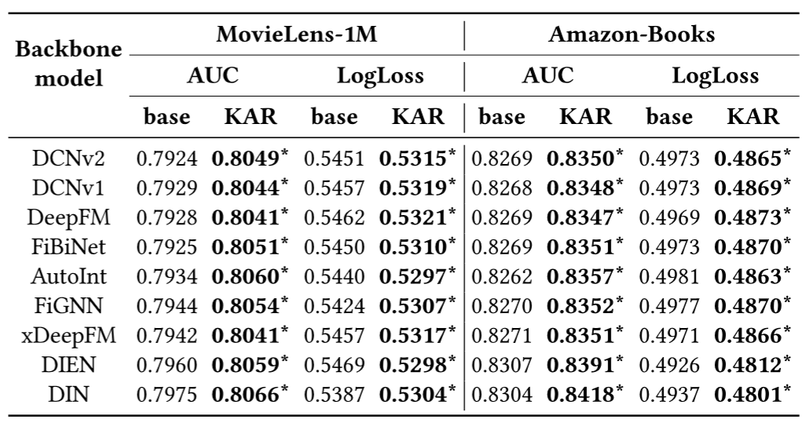
Generative LLM for Knowledge Augmentation
Towards Open-World Recommendation with Knowledge Augmentation from Large Language Models
Introducing external knowledge, which brings a small improvement in effect
Xi, Yunjia, et al. "Towards Open-World Recommendation with Knowledge Augmentation from Large Language Models." arXiv preprint arXiv:2306.10933 (2023).

Slide 29
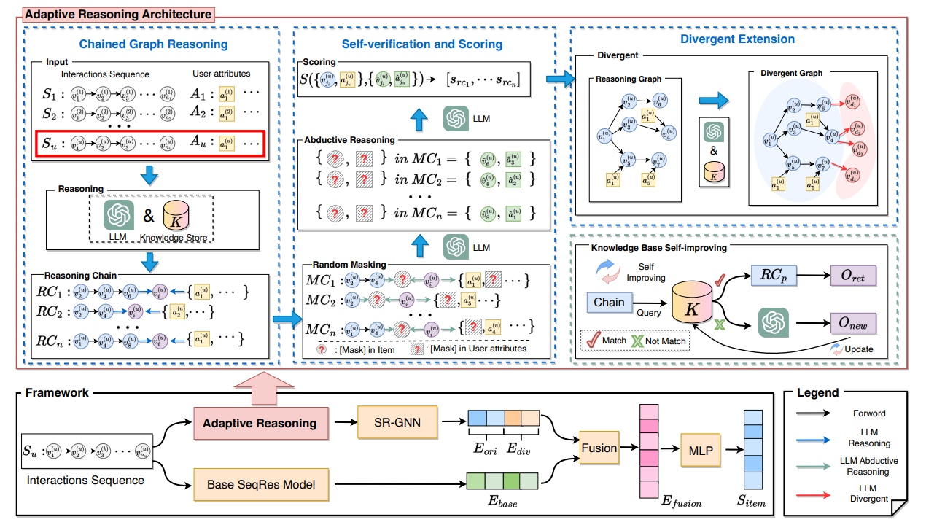
Generative LLM for Knowledge Augmentation
Enhancing Recommender Systems with Large Language Model Reasoning Graphs
LLM graph completing
Notes:
Enhancing Recommender Systems with Large Language Model Reasoning Graphs
https://arxiv.org/pdf/2308.10835.pdf

Slide 30
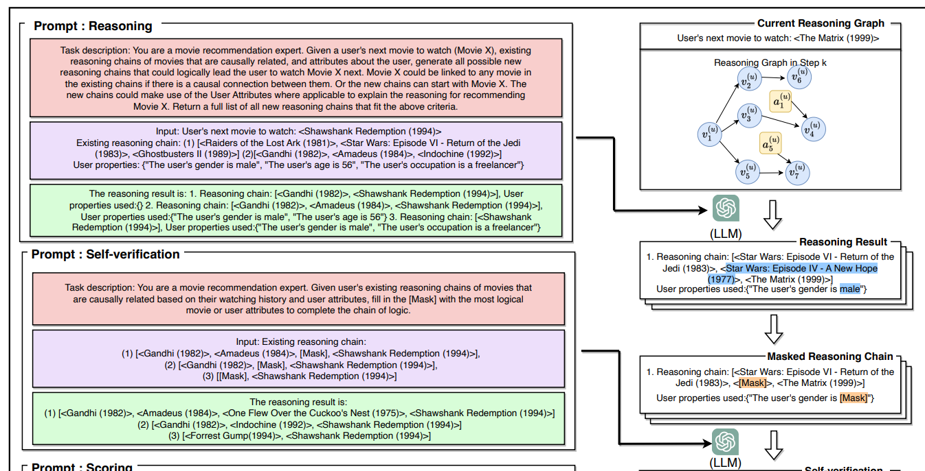
Generative LLM for Knowledge Augmentation
Enhancing Recommender Systems with Large Language Model Reasoning Graphs
LLM graph completing
Notes:
Enhancing Recommender Systems with Large Language Model Reasoning Graphs
https://arxiv.org/pdf/2308.10835.pdf

Slide 31
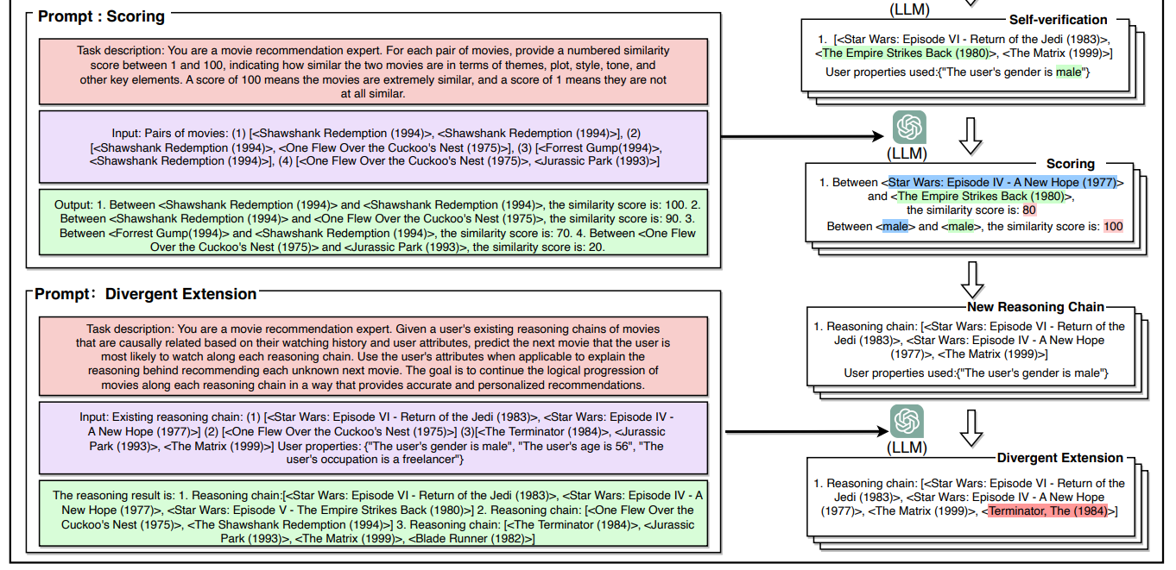
Generative LLM for Knowledge Augmentation
Enhancing Recommender Systems with Large Language Model Reasoning Graphs
LLM graph completing
Notes:
Enhancing Recommender Systems with Large Language Model Reasoning Graphs
https://arxiv.org/pdf/2308.10835.pdf

Slide 32
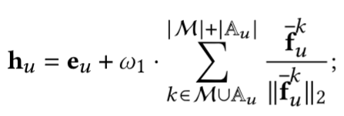
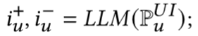
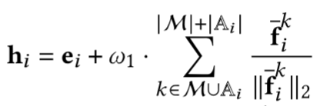
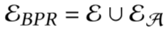
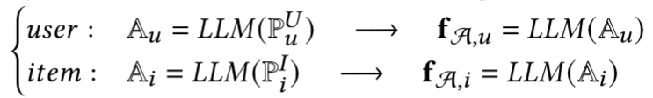
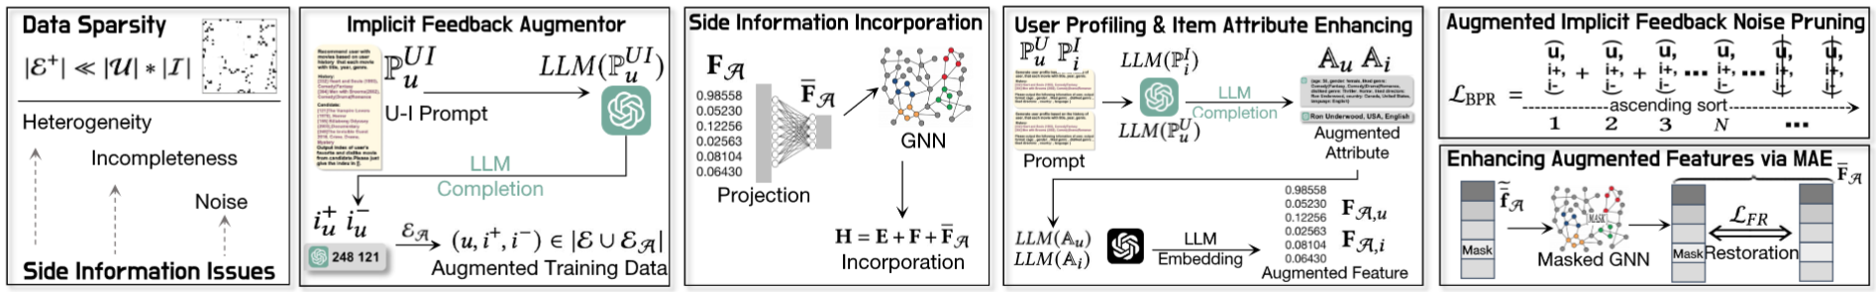
Generative LLM for Knowledge Augmentation
LLMRec: Large Language Models with Graph Augmentation for Recommendation
Data noise, Data heterogeneity and Data incompleteness.
Wei, Wei, et al. "LLMRec: Large Language Models with Graph Augmentation for Recommendation." arXiv preprint arXiv:2311.00423 (2023).

Slide 33
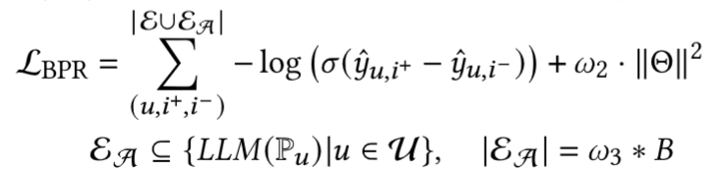
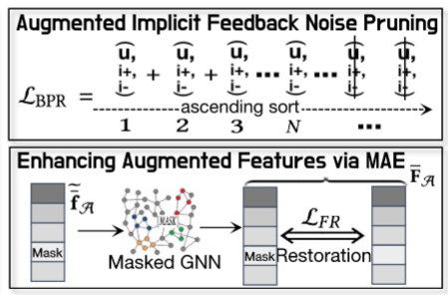
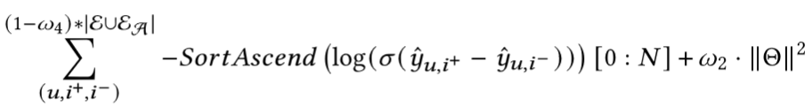
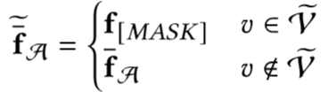
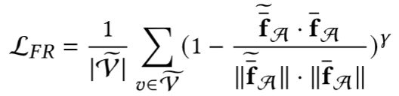
Generative LLM for Knowledge Augmentation
LLMRec: Large Language Models with Graph Augmentation for Recommendation
Data noise, Data heterogeneity and Data incompleteness.
Wei, Wei, et al. "LLMRec: Large Language Models with Graph Augmentation for Recommendation." arXiv preprint arXiv:2311.00423 (2023).

Slide 34
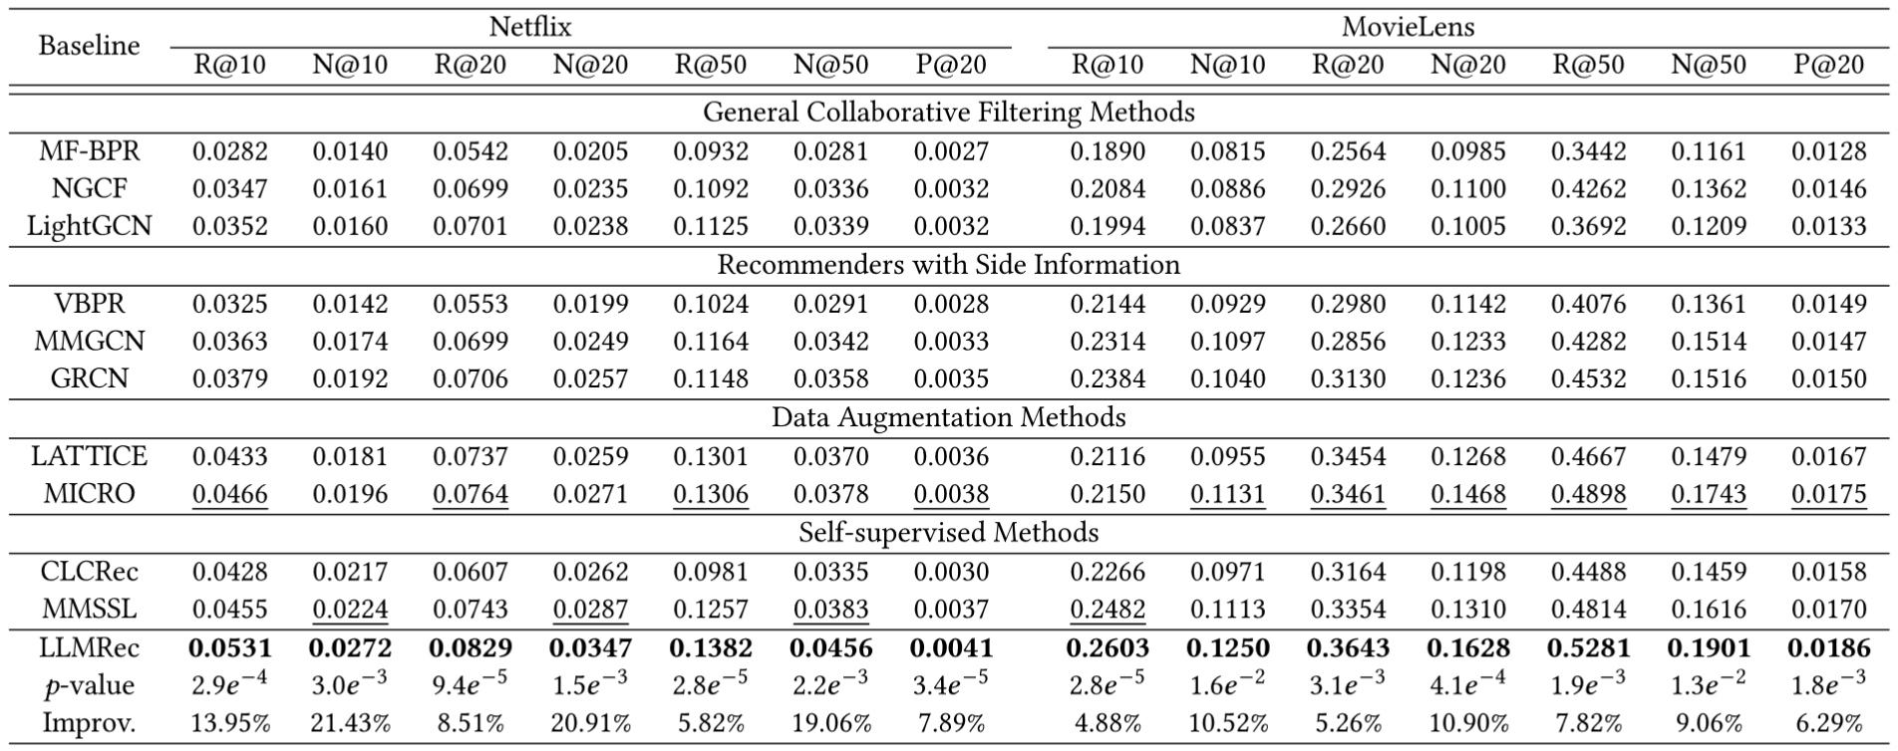
Generative LLM for Knowledge Augmentation
LLMRec: Large Language Models with Graph Augmentation for Recommendation
Overall Performance
Wei, Wei, et al. "LLMRec: Large Language Models with Graph Augmentation for Recommendation." arXiv preprint arXiv:2311.00423 (2023).

Slide 35
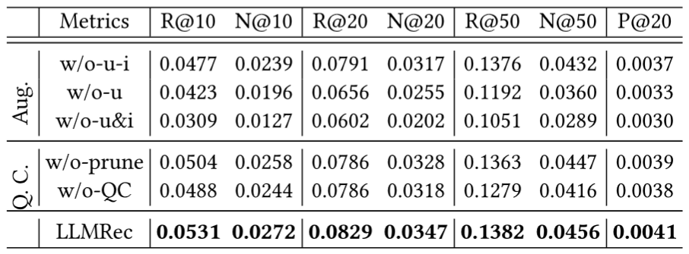
Generative LLM for Knowledge Augmentation
LLMRec: Large Language Models with Graph Augmentation for Recommendation
w/o-u-i: without LLM-augment
w/o-u: without user profile
w/o-u&i: without user and item profile
w/o-prune: without noise pruning
w/o-QC: without noise pruning and MAE
Wei, Wei, et al. "LLMRec: Large Language Models with Graph Augmentation for Recommendation." arXiv preprint arXiv:2311.00423 (2023).

Slide 36
Catalog
Background
Problem Definition
Methods Summary
Knowledge Augmentation for Generative LLM
Generative LLM for Knowledge Augmentation
Discriminative Model
Pretraining-finetuning
Resources and supplement
Outlook

Slide 37
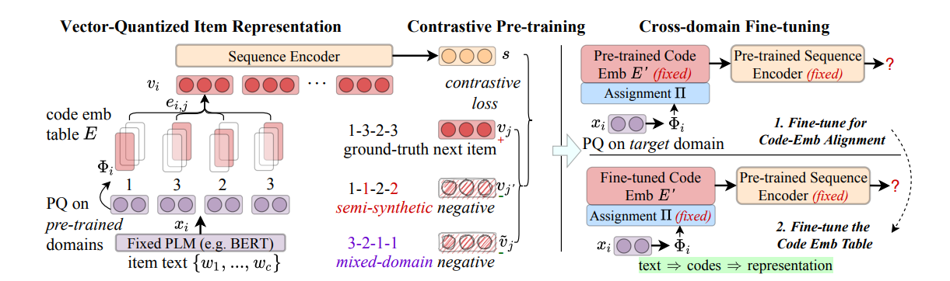
Knowledge Augmentation for Generative LLM
Language Models Can Improve Event Prediction by Few-Shot Abductive Reasoning
Notes:
Learning Vector-Qantized Item Representation for Transferable Sequential Recommenders https://dl.acm.org/doi/pdf/10.1145/3543507.3583434

Slide 38
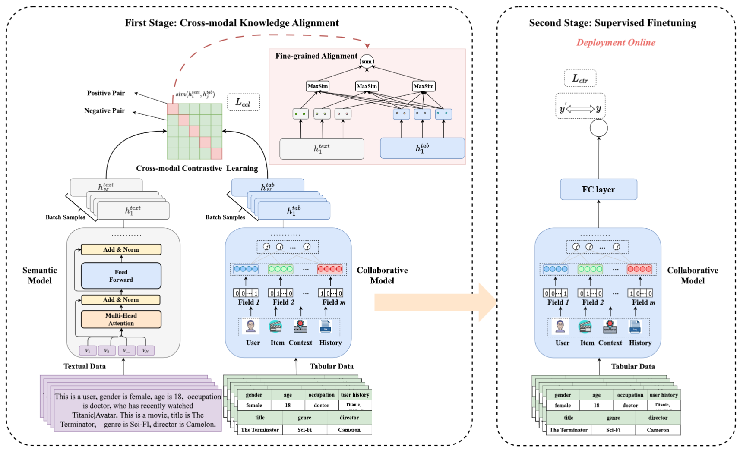
Generative LLM for Knowledge Augmentation
CTRL: Connect Tabular and Language Model for CTR Prediction
LLM can’t model collaborative signals and leads to high online complexity.
Using LLM and CTR model to separately encode text and feature information, and then using contrastive learning to improve CTR model’s representation.
Li, Xiangyang, et al. "CTRL: Connect Tabular and Language Model for CTR Prediction." arXiv preprint arXiv:2306.02841 (2023).

Slide 39
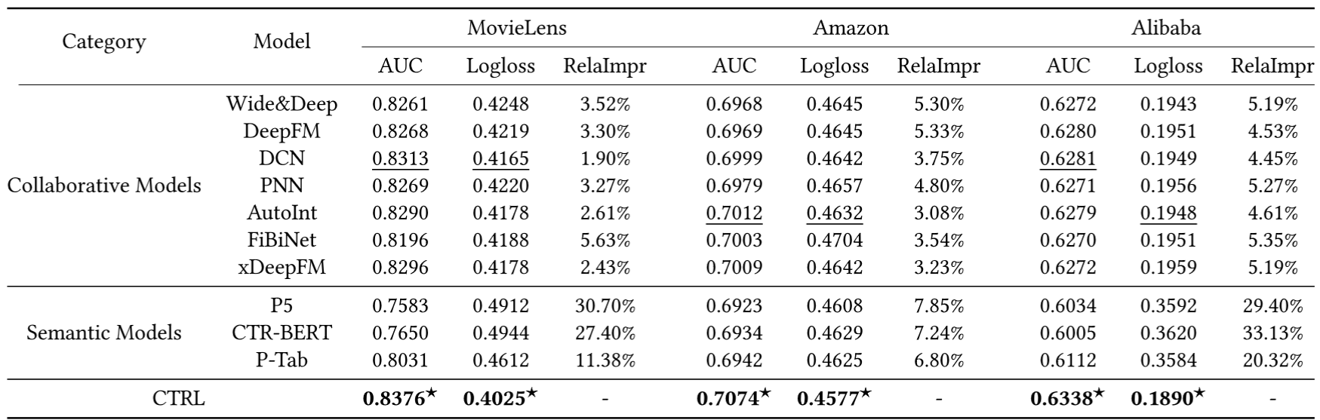
Generative LLM for Knowledge Augmentation
CTRL: Connect Tabular and Language Model for CTR Prediction
Without compromising online efficiency, model has achieved significant improvements in recommendation results.
Li, Xiangyang, et al. "CTRL: Connect Tabular and Language Model for CTR Prediction." arXiv preprint arXiv:2306.02841 (2023).

Slide 40
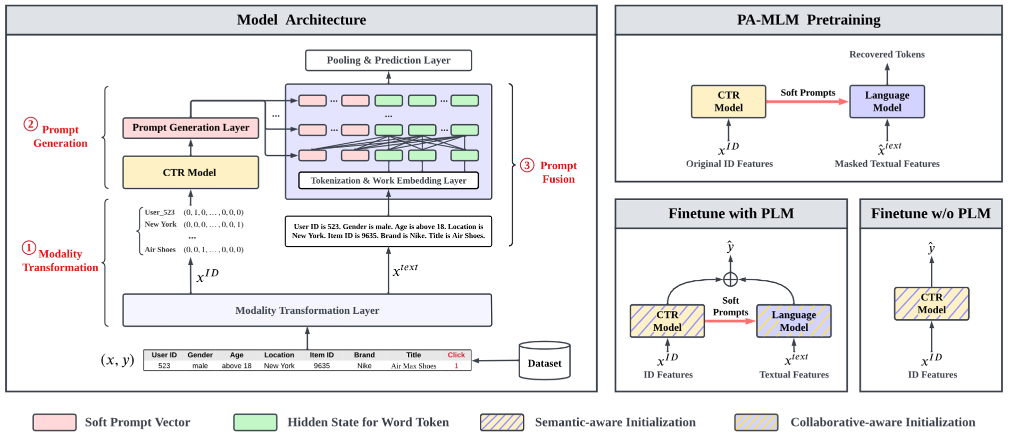
Generative LLM for Knowledge Augmentation
ClickPrompt: CTR Models are Strong Prompt Generators for Adapting Language Models to CTR Prediction
Utilizing the ID model to transform the ID representation into a soft prompt.
Pooling the results from the ID model and the PLM to obtain the final result.
Lin, Jianghao, et al. "ClickPrompt: CTR Models are Strong Prompt Generators for Adapting Language Models to CTR Prediction." arXiv preprint arXiv:2310.09234 (2023).

Slide 41
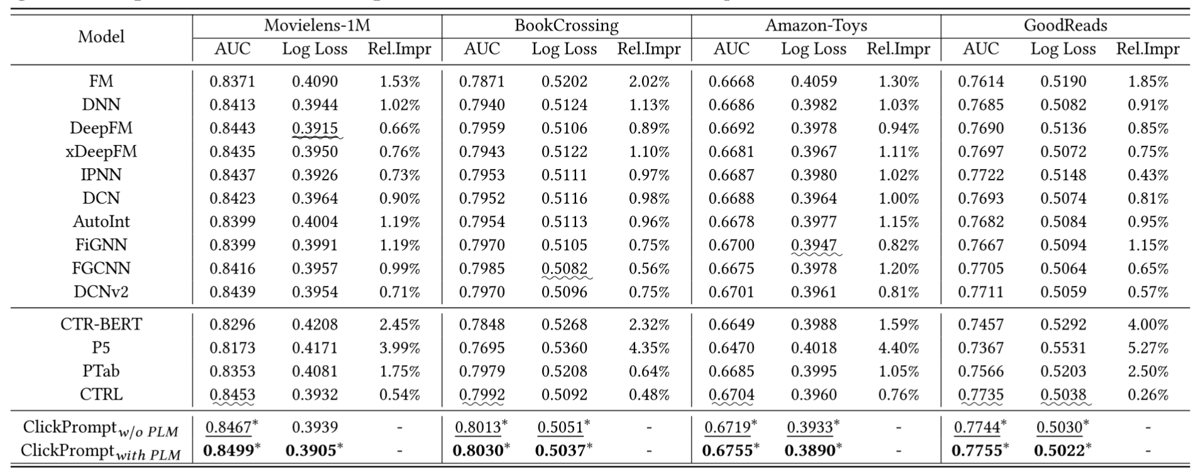
Generative LLM for Knowledge Augmentation
ClickPrompt: CTR Models are Strong Prompt Generators for Adapting Language Models to CTR Prediction
The results achieved with ClickPrompt have shown a slight improvement.
The recommendation training strategy focused on soft prompts itself can enhance recommendation performance.
Lin, Jianghao, et al. "ClickPrompt: CTR Models are Strong Prompt Generators for Adapting Language Models to CTR Prediction." arXiv preprint arXiv:2310.09234 (2023).

Slide 42
Catalog
Background
Problem Definition
Methods Summary
Knowledge Augmentation for Generative LLM
Generative LLM for Knowledge Augmentation
Discriminative Model
Resources and supplement
Outlook

Slide 43
Resources and supplement
Datasets
Amazon Review
Amazon-M2Steam
Steam
MovieLens
Yelp
Douban
MIND
arXiv
U-NEED
NineRec
Code
https://github.com/XiaoxinHe/Awesome-Graph-LLM
Notes:
MIND是用户对英文新闻的评论，包括新闻的文本内容
U-NEED是带注释的售前对话，包含用户行为和产品知识
NineRec是一套多模态迁移学习数据集，一个大规模预训练数据集和9个下游任务数据集

Slide 44
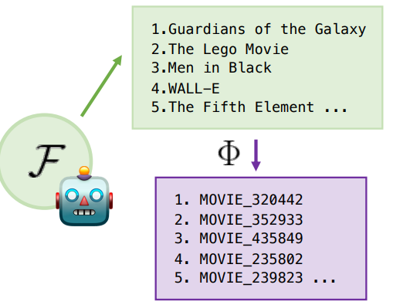
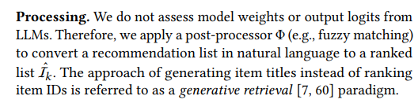
Knowledge Augmentation for Generative LLM
Grounding method
Fuzzy matching
Notes:
Large Language Models as Zero-Shot Conversational Recommenders
https://arxiv.org/pdf/2308.10053.pdf
本文的methodology只有1/4页

Slide 45
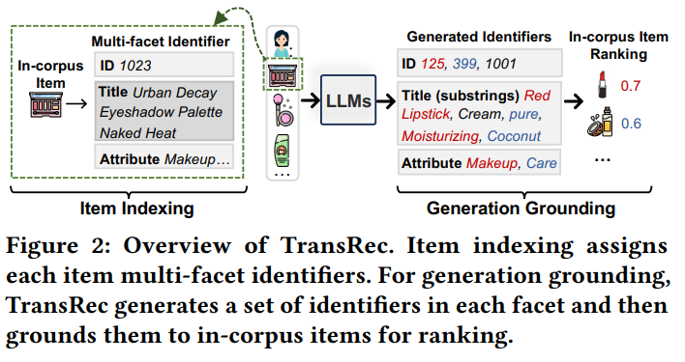
Knowledge Augmentation for Generative LLM
Attribute Grounding
Notes:
A Multi-facet Paradigm to Bridge Large Language Model and Recommendation
https://arxiv.org/pdf/2310.06491.pdf
提出了该数据集，其中的attribute也可以由大模型给定

Slide 46
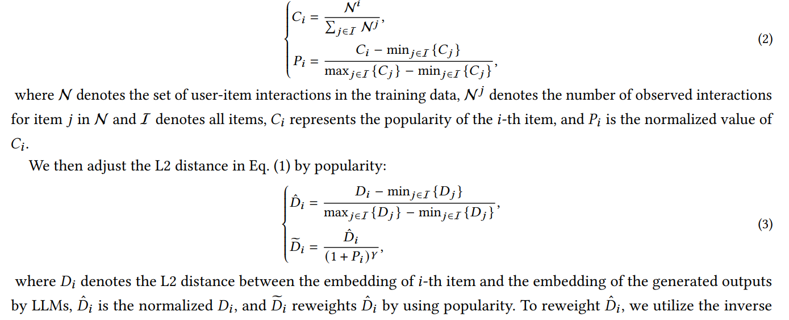
Knowledge Augmentation for Generative LLM
LLM embeddings
Other Ranking Method (Statistical Information)
Notes:
A Multi-facet Paradigm to Bridge Large Language Model and Recommendation
https://arxiv.org/pdf/2310.06491.pdf
提出了该数据集，其中的attribute也可以由大模型给定

Slide 47
Catalog
Background
Problem Definition
Methods Summary
Knowledge Augmentation for Generative LLM
Generative LLM for Knowledge Augmentation
Discriminative Model
Resources and supplement
Outlook

Slide 48
Outlook
Knowledge Augmentation for Generative LLM
A more high-quality and efficient prompt generation module.
Better alignment between the results of LLM and the recommended lists.
More efficient inference.
Generative LLM for Knowledge Augmentation
Obtaining higher-quality embeddings.
More efficient representations.
Deeper integration with downstream recommendation models.
Discriminative Model
Better fine-tuning strategies.

